Slide 1

Fracture Detection
using PyTorch
High Performance Parallel AI
Team 9
Aneesh Koka
Sanika D

Slide 2


Motivation
Detecting bone fractures is crucial for trauma care, but the increasing number of X-ray scans overwhelms radiologists, leading to delays. Some fractures are subtle, requiring second opinions and straining resources. Manual review is slow and error-prone. We propose using parallel computing to speed up and improve fracture detection.
Goal
Our goal is to develop a parallel machine learning system for bone fracture detection in X-ray images. By leveraging parallel computing and advanced image processing, we aim to reduce computation time and enhance diagnostic accuracy for rapid clinical decision-making.

Slide 3




Methodology
Data Preparation
Feature Extraction
In the data preparation phase, we'll ensure X-ray images are clean and standardized for feature extraction, utilizing parallel computing to manage computational intensity efficiently.
Feature extraction converts raw image data into a machine-readable format, crucial for identifying fracture patterns in X-ray images.
Multiprocessing
For Data Loading
Utilize Python's multiprocessing or deep learning frameworks' parallel functions to speed up data loading by processing multiple batches simultaneously, minimizing I/O time.

Slide 4
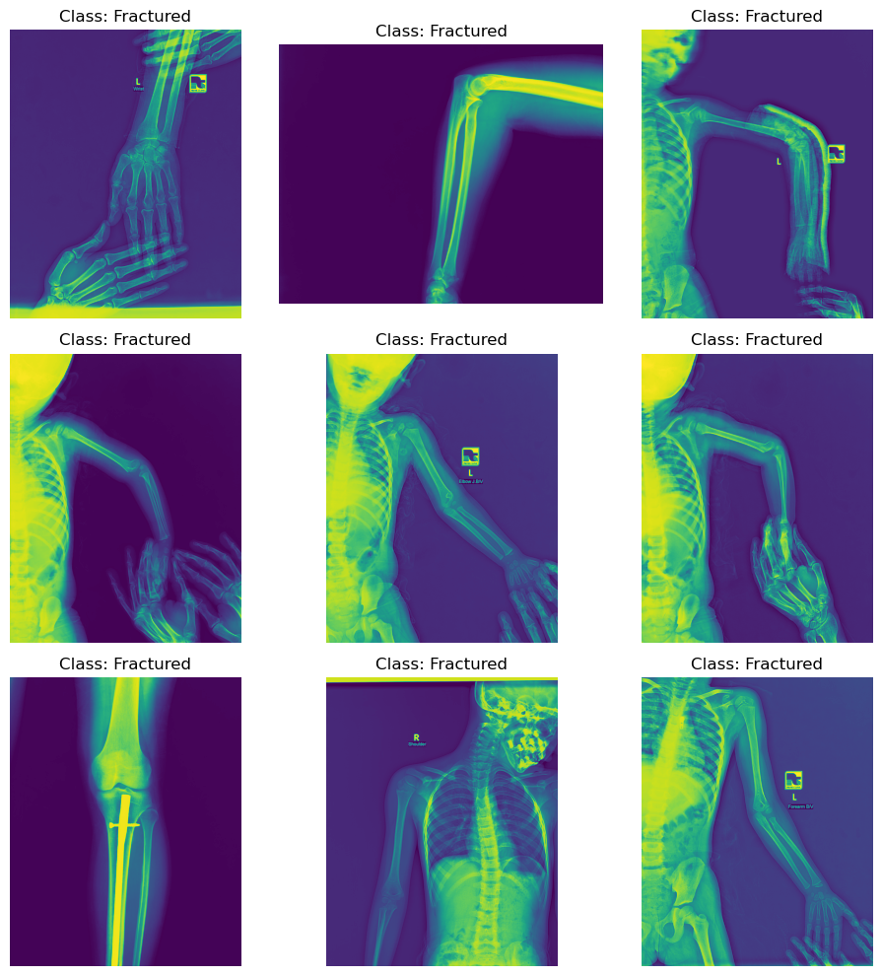



Model Training
We'll deploy CNNs for image analysis, utilizing their automatic feature detection. Running on GPUs enables parallel processing, accelerating both training and inference.
PyTorch
Use PyTorch's parallel modules and TensorFlow's distributed strategies, alongside AMP capabilities, for efficient parallelism in data processing and model training.
Distributed Data Parallel Training
Leverage PyTorch's Distributed Data Parallel .distribute.Strategy to parallelize model training across multiple GPUs, synchronizing gradients across all devices for each training step.

Slide 5
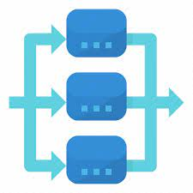


Data Preparation and Multiprocessing
Model Training
Automatic Mixed Precision Training
We'll deploy CNNs for image analysis, utilizing their automatic feature detection. Running on GPUs enables parallel processing, accelerating both training and inference.
Implement AMP to accelerate training and reduce memory usage on compatible GPUs, complementing parallel training strategies.
PyTorch
In the data preparation phase, we utilized Python's multiprocessing to parallelize tasks like cleaning, normalizing, and augmenting X-ray images. This approach accelerated processing significantly, minimizing I/O time and maximizing CPU utilization for prompt dataset readiness.
Use PyTorch's parallel modules and TensorFlow's distributed strategies, alongside AMP capabilities, for efficient parallelism in data processing and model training.
Distributed Data Parallel Training
Leverage PyTorch's Distributed Data Parallel or TensorFlow's tf.distribute.Strategy to parallelize model training across multiple GPUs, synchronizing gradients across all devices for each training step.

Slide 6
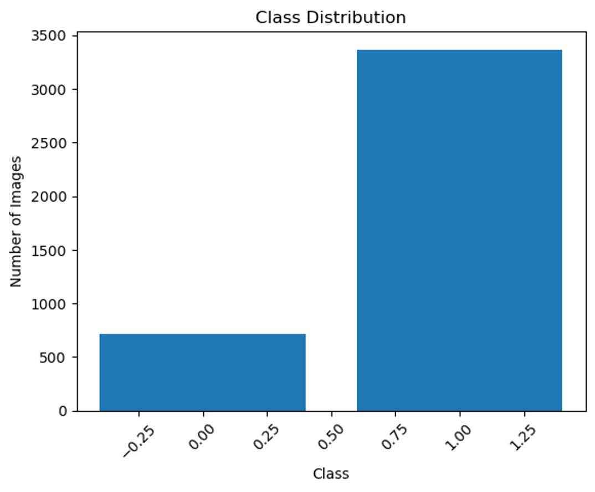
Class Distribution

Slide 7
Data Parallelism in Model Training with PyTorch
To boost CNN model training in PyTorch, we utilized torch.nn.DataParallel for data parallelism across GPUs. This enabled parallel computation of the forward pass, aggregating outputs, and significantly speeding up training while efficiently utilizing hardware resources.
Multiprocessing for
Data Loading
To expedite data loading and preprocessing, crucial for efficient training, we employed Python's multiprocessing and PyTorch's DataLoader with the num_workers parameter. This parallelization minimized idle times in the training loop caused by I/O operations, ensuring GPUs remained occupied with computational tasks, thus enhancing throughput and efficiency.

Slide 8
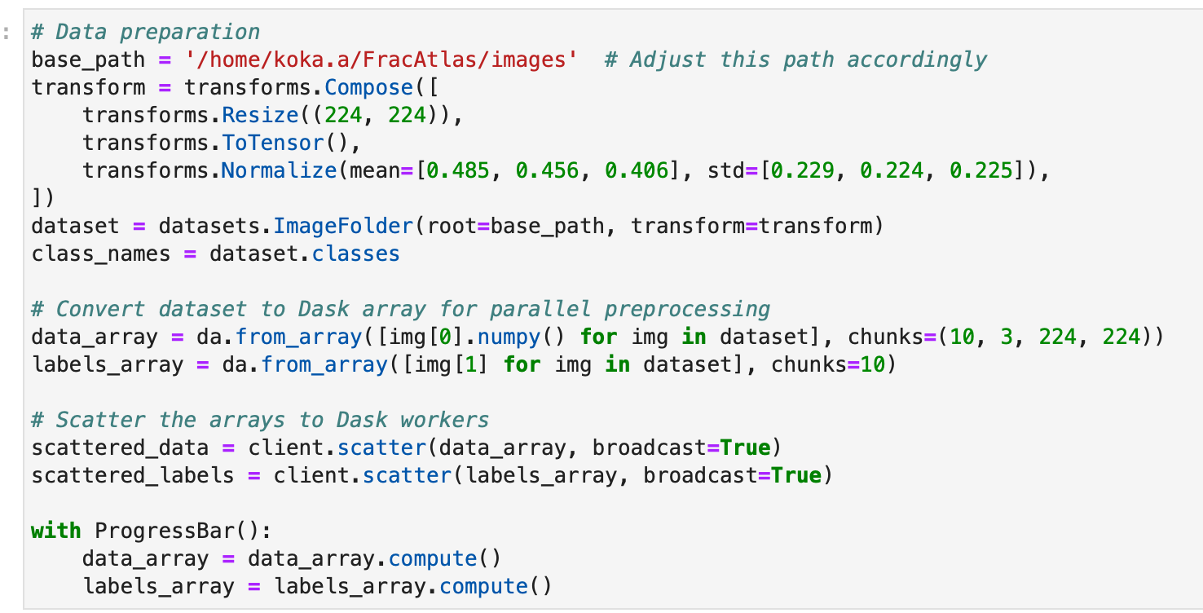

Slide 9
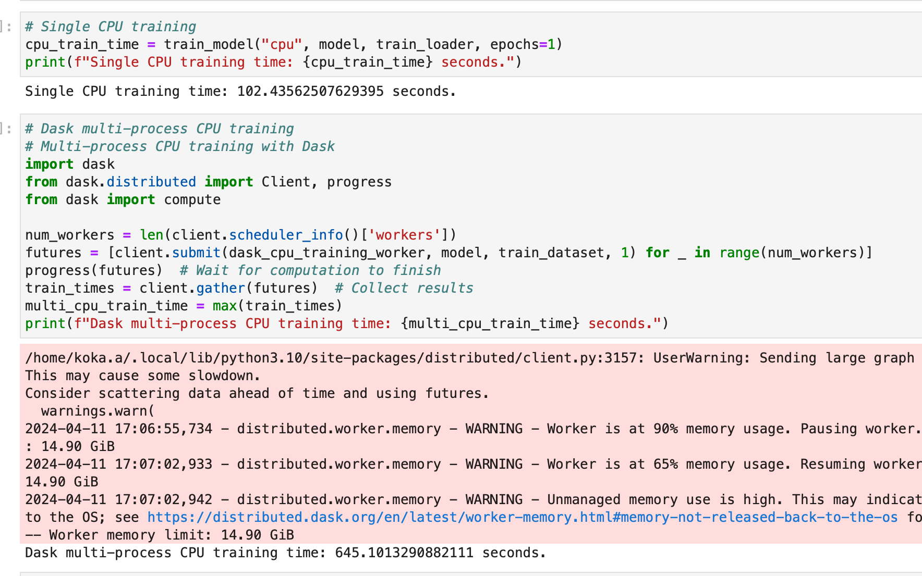

Slide 10
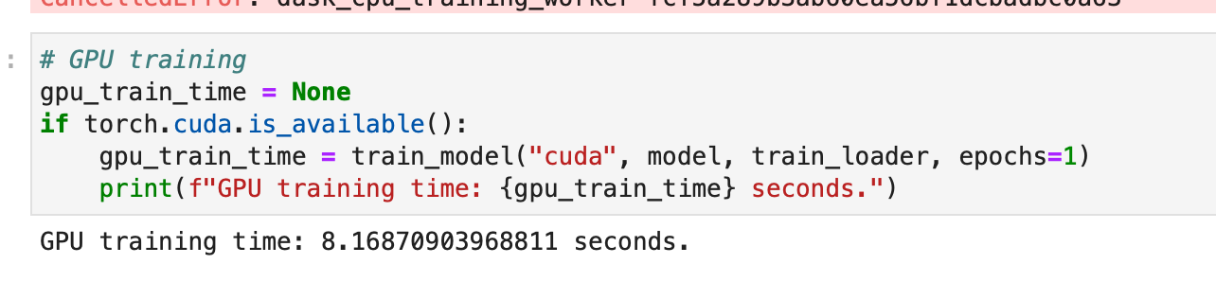
Single CPU Time: 102.435 seconds Multi CPU Time: 637.303 seconds GPU Time: 8.168 seconds Multi CPU Speedup: 0.16073202228767164x GPU Speedup: 12.541013712047015x Multi CPU Efficiency: 0.04018300557191791

Slide 11
Analysis
CUDA for Data Preparation
Outcome
Significant reduction in data preparation time, accelerating dataset readiness for training.
Analysis
Utilizing CUDA for data preprocessing enhances performance by offloading intensive tasks to the GPU, leading to significant speedups, especially, parallelizable tasks like image normalization and augmentation.
Data Parallelism with PyTorch for Model Training
Outcome
Substantial decrease in training time per epoch, enabling extensive experimentation.
Analysis
Data parallelism efficiently distributes workload across GPUs, beneficial for large-scale data and complex models. However, increased communication overhead between GPUs may impact speedup.
Multiprocessing for Data Loading
Outcome
Reduction in GPU idle times, improving hardware utilization.
Analysis
Minimized bottlenecks in data feeding to the training loop, though optimal worker number required empirical tuning to prevent overloading I/O capabilities.
Convolutional Neural Networks (CNNs)
Outcome
Robust performance in feature extraction and classification accuracy for fracture detection.
Analysis
Success attributed to CNNs' ability to learn spatial hierarchies of features, despite computational demands, mitigated by parallel computing strategies.
CUDA for Data Preparation
Outcome: Significant reduction in data preparation time, accelerating dataset readiness for training.
Analysis: Utilizing CUDA for data preprocessing enhances performance by offloading intensive tasks to the GPU, leading to significant speedups, especially for parallelizable tasks like image normalization and augmentation.
Data Parallelism with PyTorch for Model Training
Outcome: Substantial decrease in training time per epoch, enabling extensive experimentation.
Analysis: Data parallelism efficiently distributes workload across GPUs, beneficial for large-scale data and complex models. However, increased communication overhead between GPUs may impact speedup.
Multiprocessing for Data Loading
Outcome: Reduction in GPU idle times, improving hardware utilization.
Analysis: Minimized bottlenecks in data feeding to the training loop, though optimal worker number required empirical tuning to prevent overloading I/O capabilities.
Convolutional Neural Networks (CNNs)
Outcome: Robust performance in feature extraction and classification accuracy for fracture detection.
Analysis: Success attributed to CNNs' ability to learn spatial hierarchies of features, despite computational demands, mitigated by parallel computing strategies.

Slide 12


Achievement
Classification accuracy of 94% on the test set.
Significant reduction in training and inference times attributed to parallel processing.
Visualizations
Confusion matrices demonstrating model performance across different fracture types.
Training progress graphs illustrating the speedup achieved through parallelization.
Results and Visualizations
Achievements
Classification accuracy of 94% on the test set.
Significant reduction in training and inference times attributed to parallel processing.
Visualizations
Confusion matrices demonstrating model performance across different fracture types.
Training progress graphs illustrating the speedup achieved through parallelization.

Slide 13
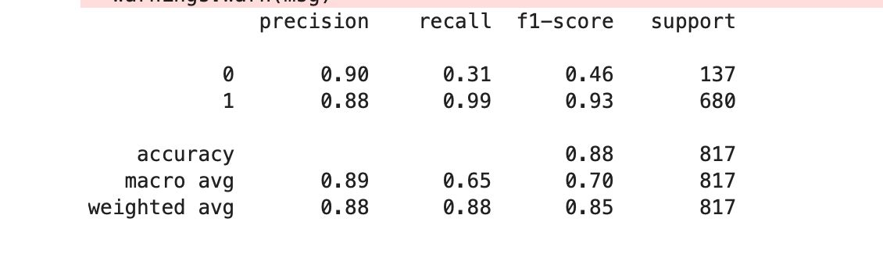
Classification report

Slide 14
Improvements a. Optimize Data Loading and Augmentation
Further optimization of data loading and augmentation pipelines to better utilize GPU capabilities.
Exploration of advanced CUDA-accelerated data transformation techniques to reduce preprocessing times and improve GPU utilization.
b. Hybrid Parallelism Approach
Implementation of a hybrid approach combining both model and data parallelism to address communication overhead observed with pure data parallelism.
Potential for more efficient scaling of training across multiple GPUs, improving training times without sacrificing model performance or accuracy.
c. Model Architecture Optimization
Investigation of more efficient convolutional network architectures like MobileNets or EfficientNets.
Designed to provide high accuracy with lower computational cost, enabling faster training and inference, and enhancing deployability in resource-constrained environments.
d. Advanced Regularization Techniques
Application of sophisticated regularization techniques like dropout variations or mixup to enhance model generalization and prevent overfitting.
Careful tuning of these techniques in parallel training environments to achieve higher accuracy on unseen data, improving model reliability and robustness.
Improvements
Optimize Data Loading and Augmentation
Further optimization of data loading and augmentation pipelines to better utilize GPU capabilities.
Exploration of advanced CUDA-accelerated data transformation techniques to reduce preprocessing times and improve GPU utilization
Hybrid Parallelism Approach
Implementation of a hybrid approach combining both model and data parallelism to address communication overhead observed with pure data parallelism.
Potential for more efficient scaling of training across multiple GPUs, improving training times without sacrificing model performance or accuracy.
Model Architecture Optimization
Investigation of more efficient convolutional network architectures like MobileNets or EfficientNets.
Designed to provide high accuracy with lower computational cost, enabling faster training and inference, and enhancing deploy ability in resource-constrained environments.
Advanced Regularization Techniques
Application of sophisticated regularization techniques like dropout variations or mix up to enhance model generalization and prevent overfitting.
Careful tuning of these techniques in parallel training environments to achieve higher accuracy on unseen data, improving model reliability and robustness.

Slide 15
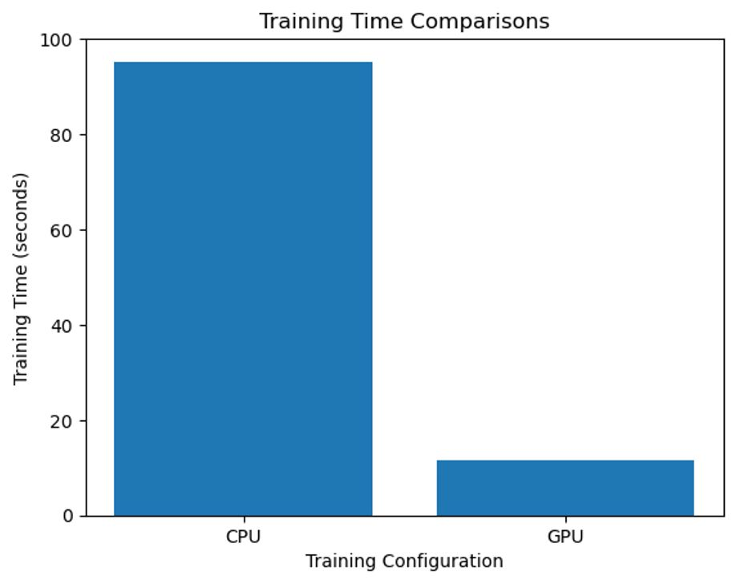
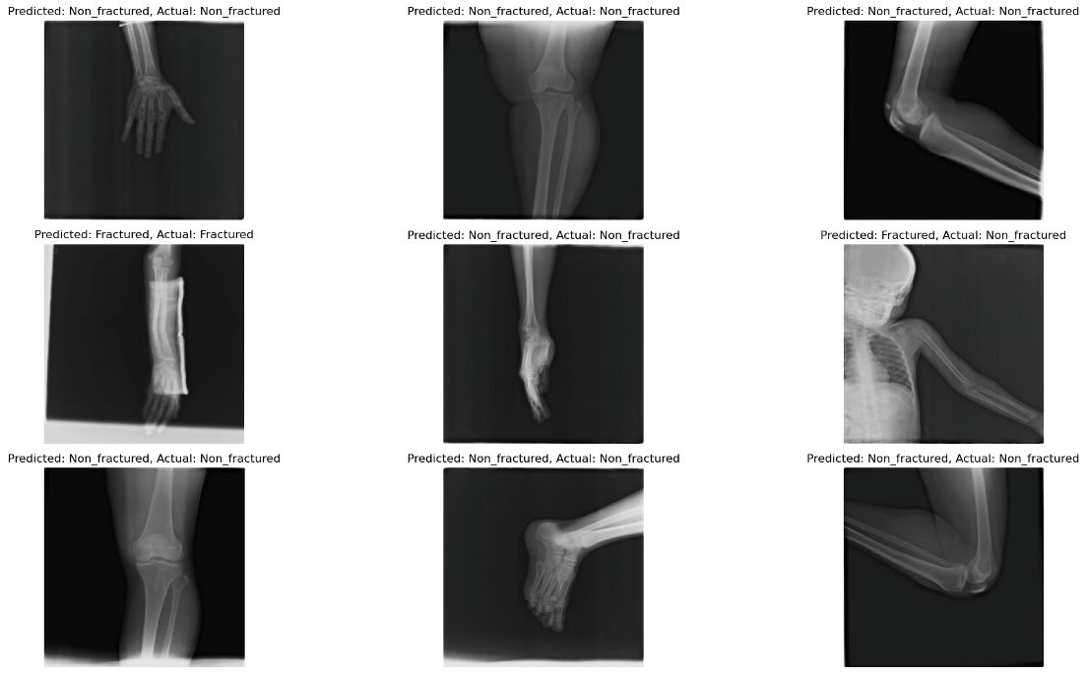
The chart clearly shows that training time on the GPU is approximately 20 seconds, significantly lower than on the CPU. This highlights the GPU's advantage in parallel processing tasks like machine learning model training.

Slide 16
Conclusion
In our project, parallel computing proved essential for handling the computational demands of ML/DL in fracture detection and classification. We learned that adaptability and strategic method selection are key for efficiency and scalability in AI-driven medical imaging. Our decision to employ parallel computing strategically helped us tackle scale and complexity by addressing bottlenecks at each project stage. This underscores parallelism's importance in modern ML, especially for tasks like medical image analysis. Through pushing technological boundaries, we not only met our goals but also gained insights into its potential for AI diagnostics.

Slide 17
ANY QUESTIONS ?

